Slide 1

Created by: Márkus Barnabás, Hauszmann Dávid

Slide 2
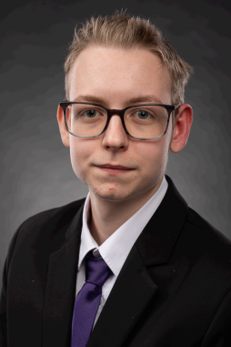
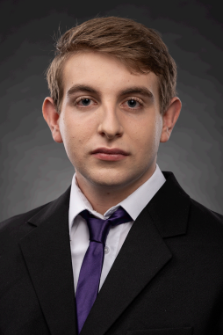
The team:
Hauszmann Dávid
Márkus Barnabás
Frontend
Design
Backend
Database
Project Manager

Slide 3
Project Plan:
Simple and fast book purchasing
Clear interface
Modern, digital solution

Slide 4
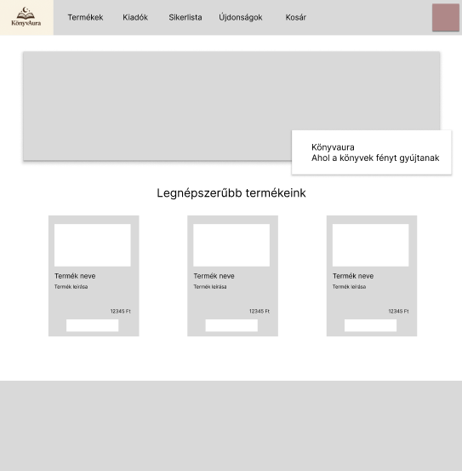
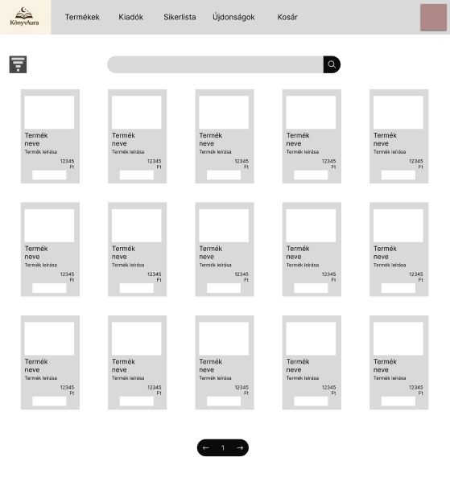
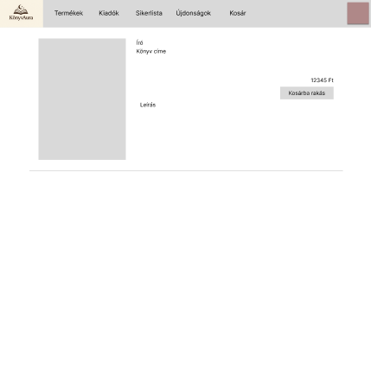
Functional design plan

Slide 5
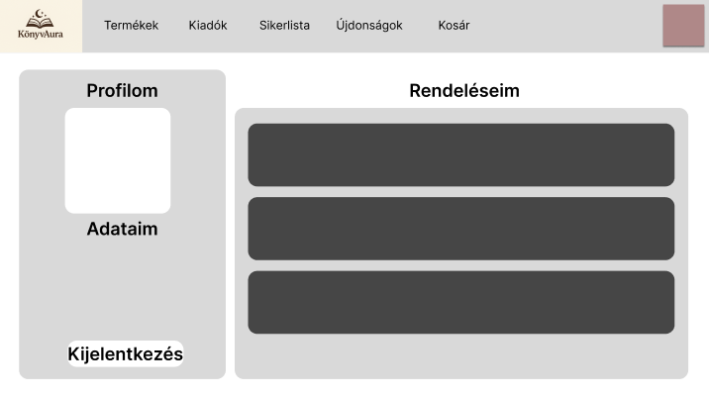
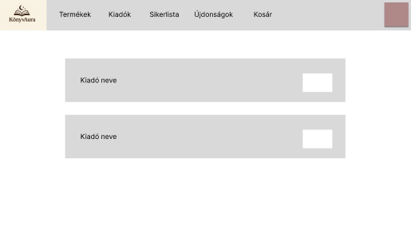
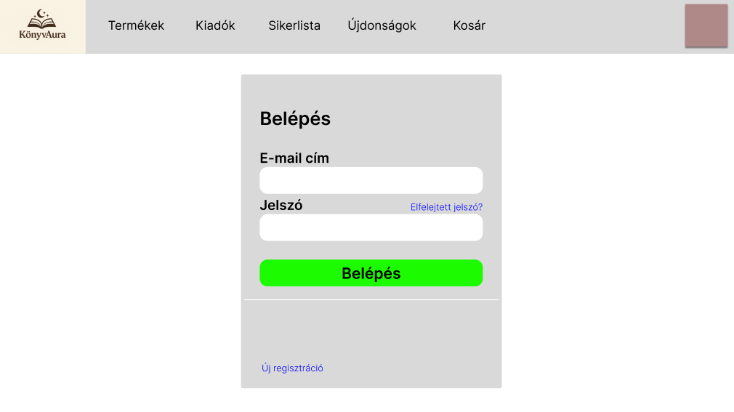

Slide 6
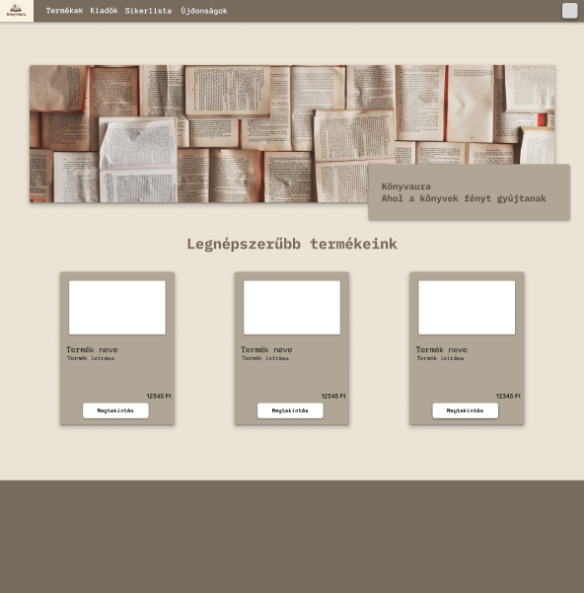
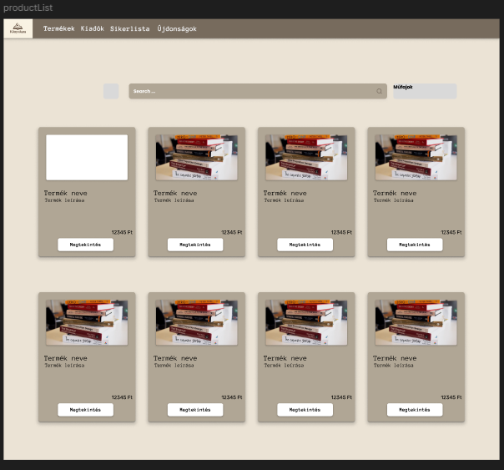
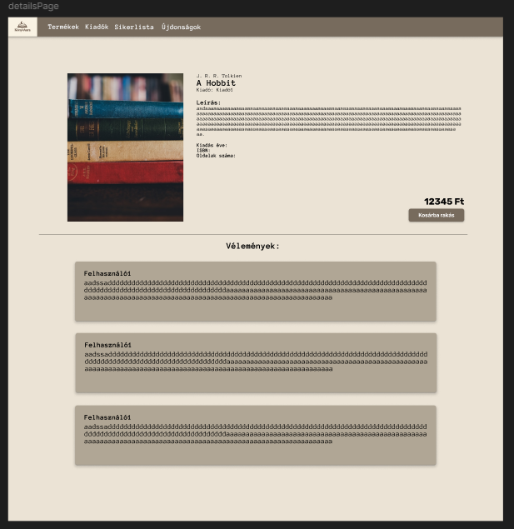
Final design plan

Slide 7
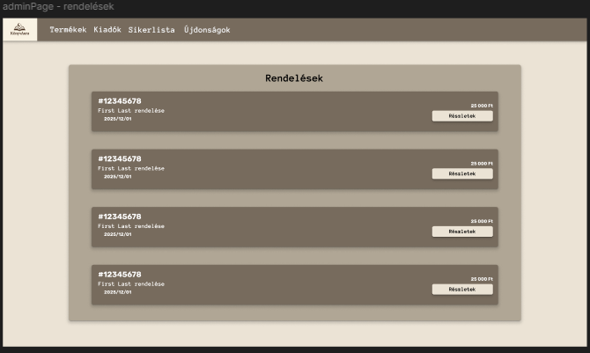
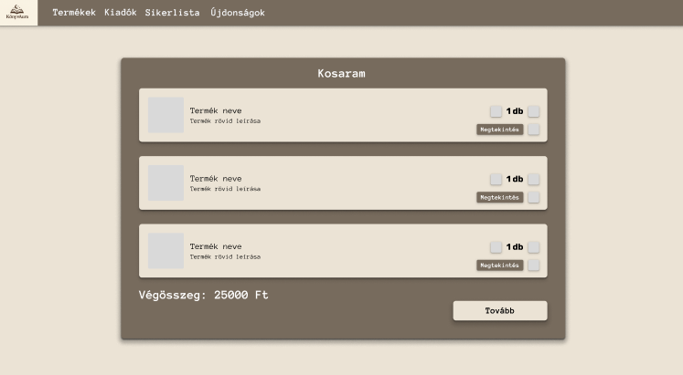
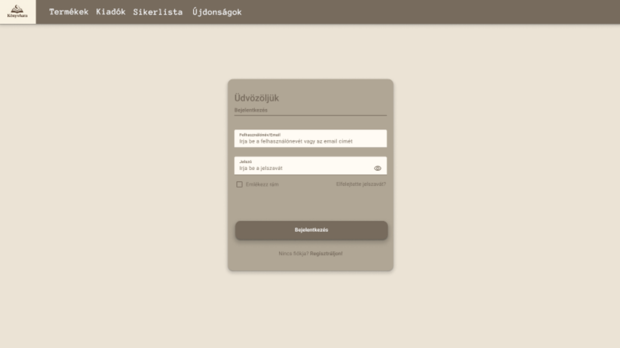

Slide 8



Phone design

Slide 9






Frontend

Slide 10
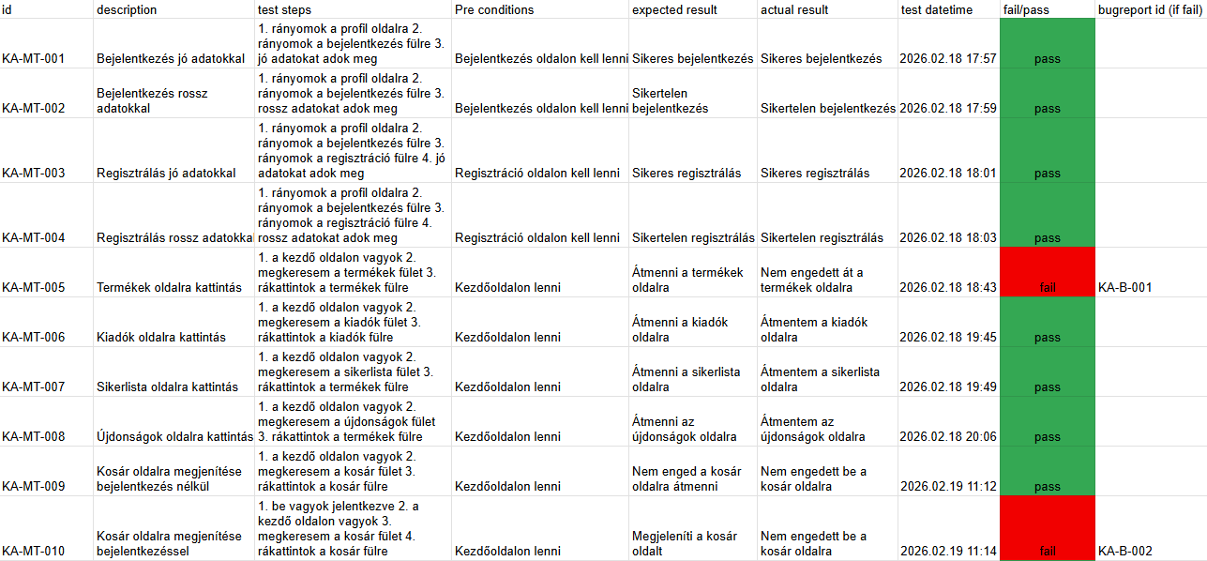
Test

Slide 11
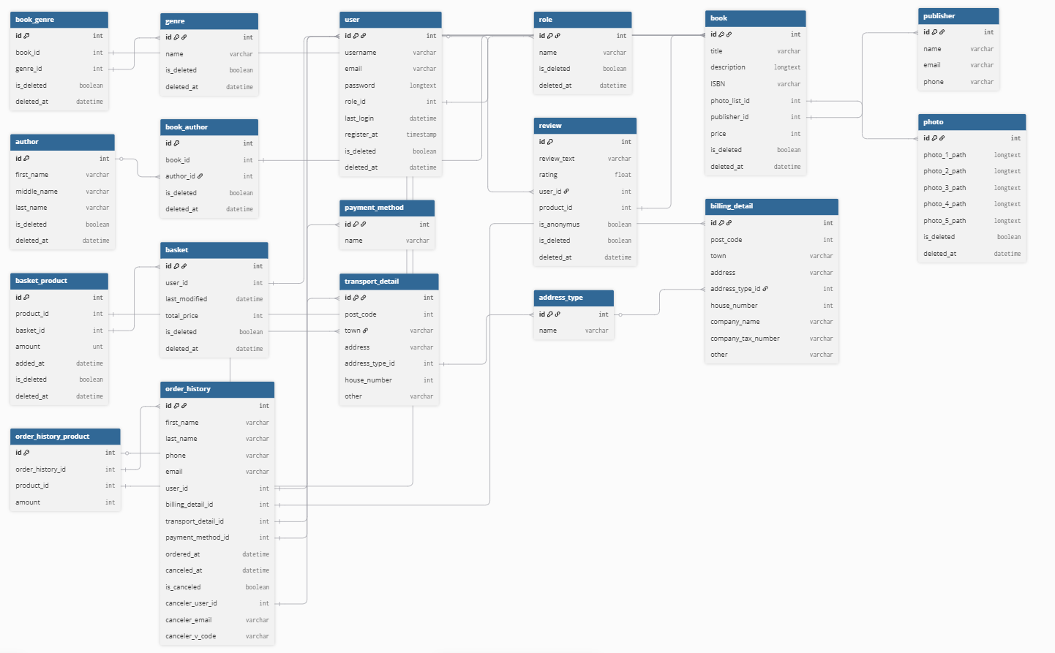


Database

Slide 12



Backend

Slide 13



Other softwares used

Slide 14
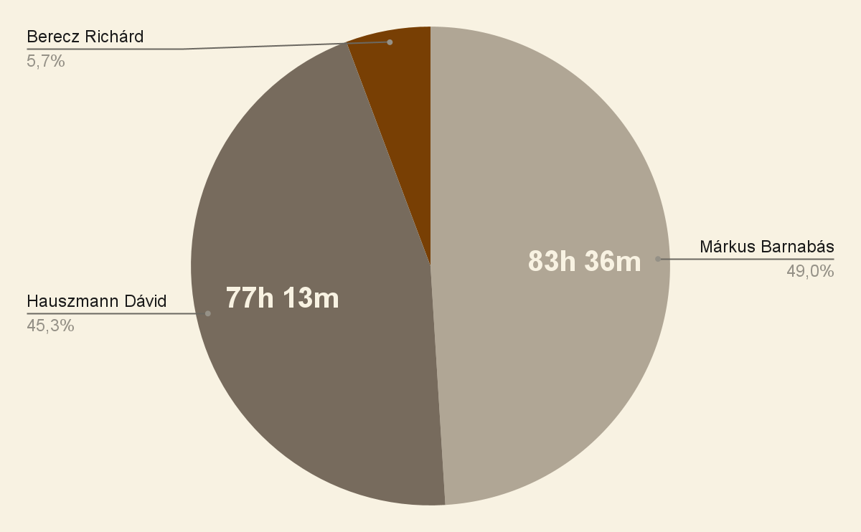
Teamwork

Slide 15
Plans for the future:
Credit card payment
Preview of books
Bonus system

Slide 16
Thank you for your attention!

